Slide 1
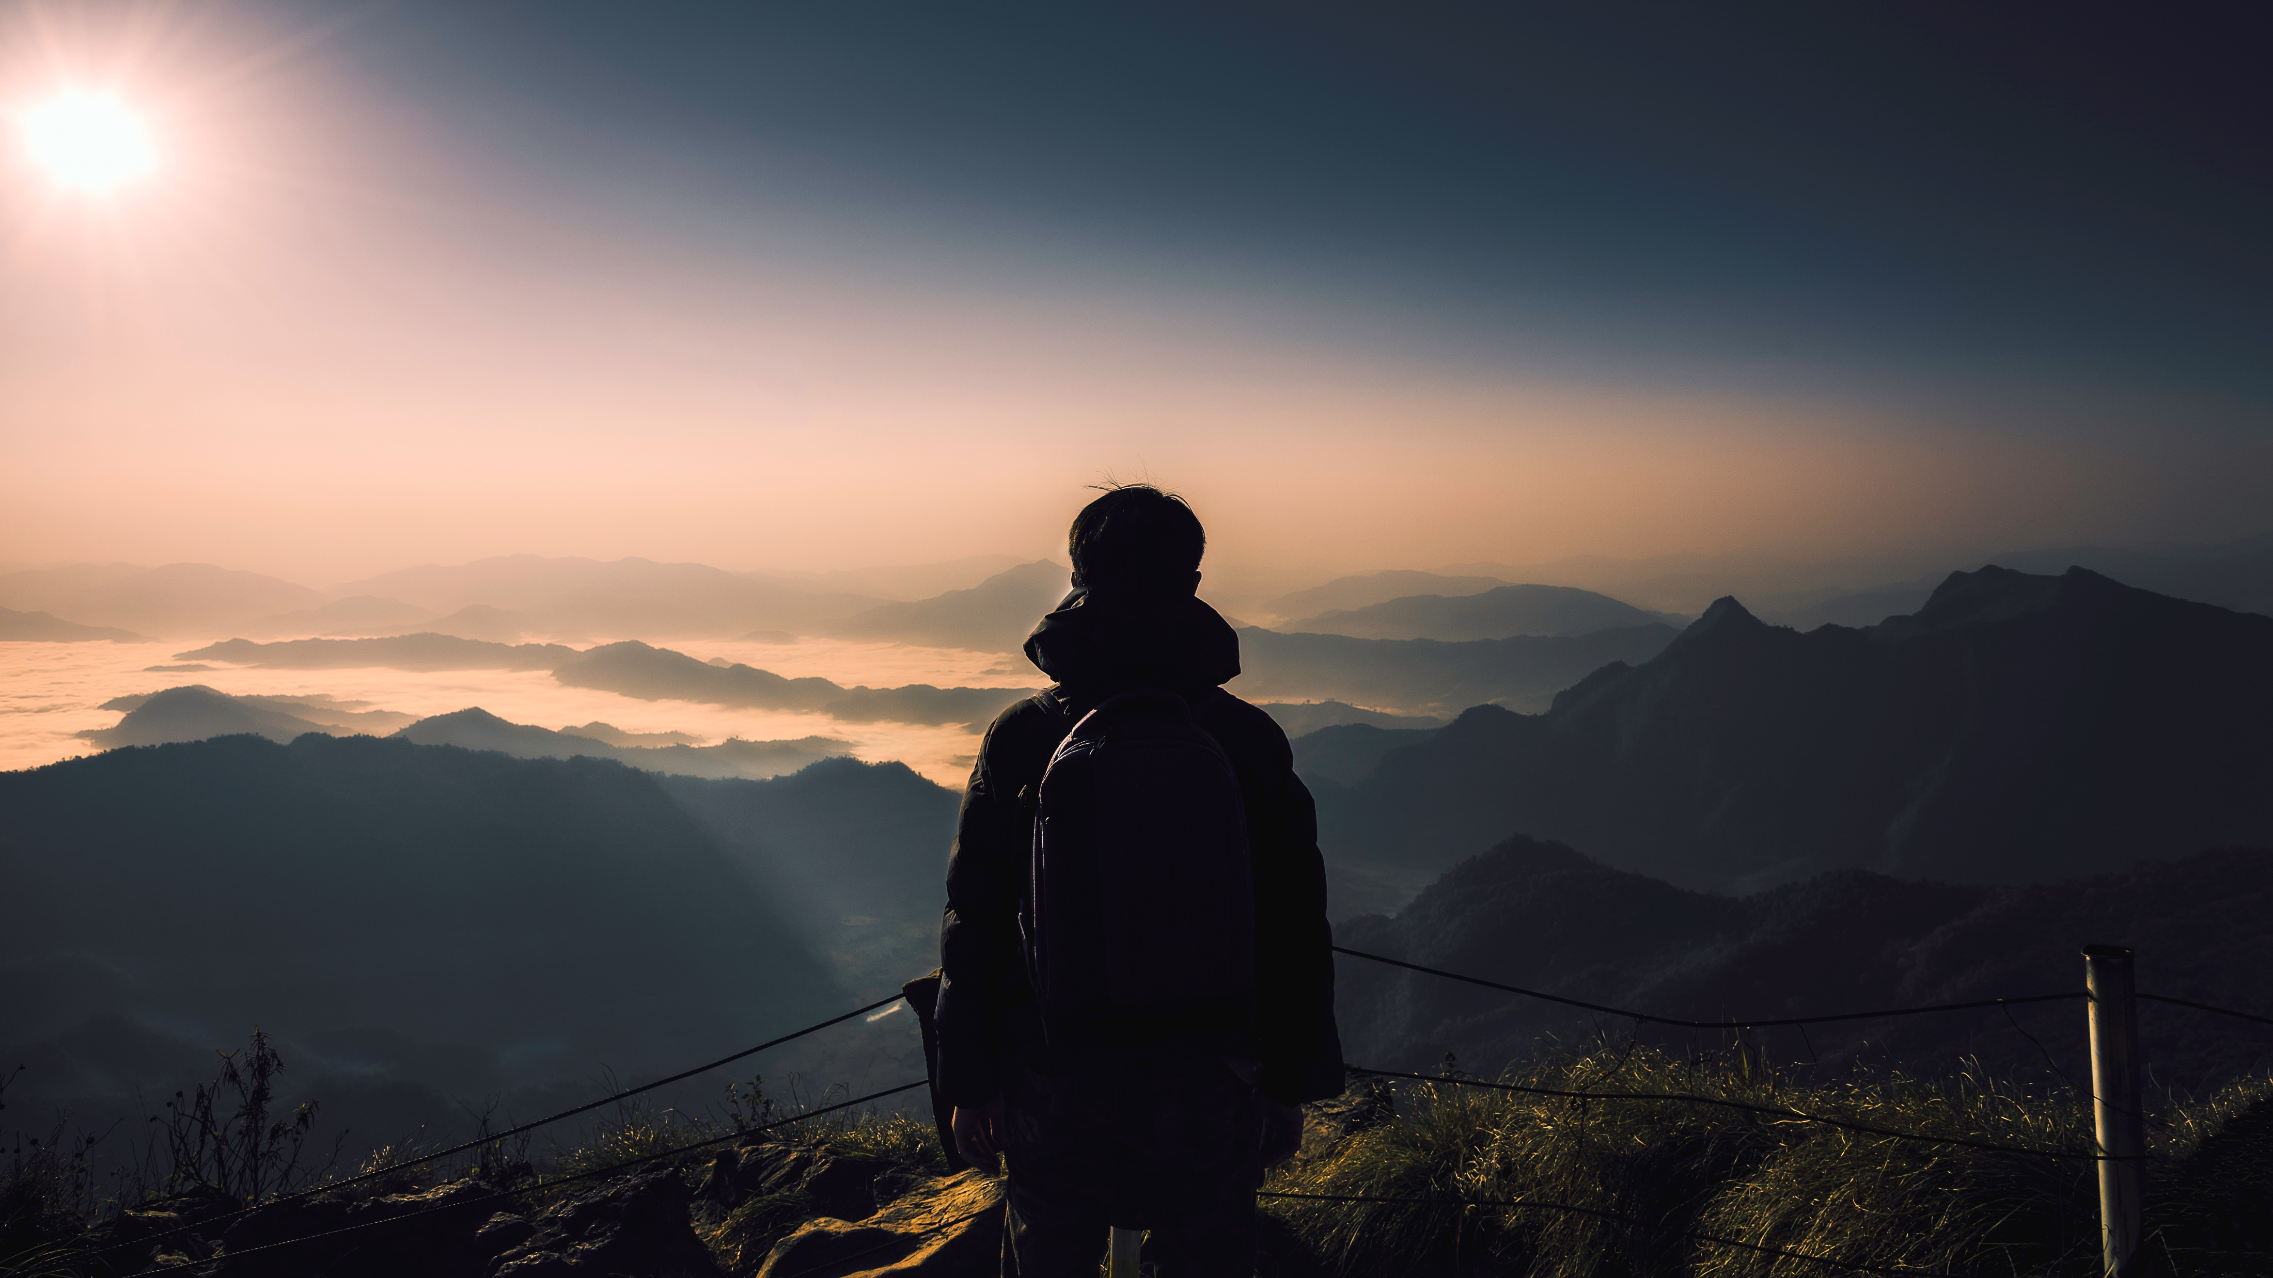
Let’s Travel
Presented by:
Rituja K. Kundalwal
Nikita P. Bhokare
Riya P.Golekar
Guided By:
Prof.S.A.Vagare

Slide 2

CONTENTS
INTRODUCTION
PURPOSE OF OUR WEBSITE
SOFTWARE REQUIREMENT
PLAN OF ACTION
MODULE OF PROJECTS
ADVANTEGES OF TRAVELLING
PROJECT SCREENSHOTS(IMPLEMENTATION)
FUTURE SCOPE
CONCLUSION
REFERENCES

Slide 3

Introduction
This application will help people from different location of india to booking or enquire the package event and payment for travelling to the book places within less time period .
Tourist are more attached toward the culture diverisity of different state around the India .
The Sum of the phenomena and relationship arising from the travel and stay of non residents.
Let’s Travel provide reservation facility to there customer.

Slide 4

PURPOSE OF OUR WEBSITE
The purpose of website is established fact that Internet users are increasing today.
Today one of the main purposes of the website is to facilitate the offline customer online because customers cannot spend their precious time in markets trying to find out the best deal.
Our priority will be our customers and their travel requirements. There will be many users visiting the portal and hence we require a strong and reliable frontend which can withhold the users on our site.
We will be putting an effort to provide the right choice to the people when they plan a holiday and beware them from the false advertising.

Slide 5
Software Requirment
Frontend Functionality : HTML, CSS
Client –side scripting: Javascript
Backend Functionality: PHP
Editor : Visual Studio code
Database: MySQL
Server Deployment: XAMPP Sever

Slide 6



Plan of Action
Set a destination and/or travel theme
Set a destination and/or travel theme
Find local attraction, toward places and activities.
1
Making of front end using programming.
2
Creating various table database as needed, and connect the frontend and backend.
3

Slide 7



Modules of a project
View Packages
Select Destination
Booking
Online Payment
Contact Us

Slide 8



Advantages of Travelling
Adventure
Enthusiasm
Discovery

Slide 9
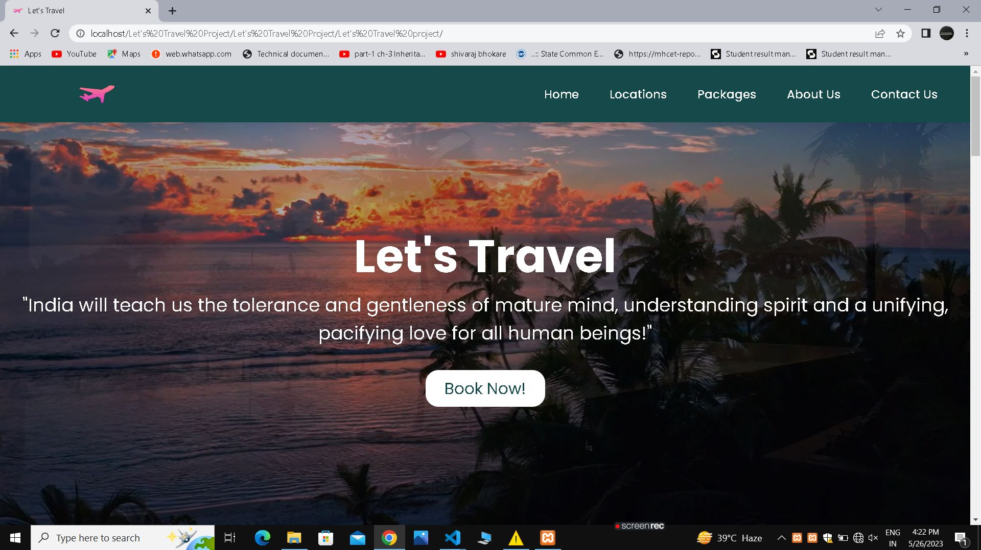
IMPLEMENTATION

Slide 10
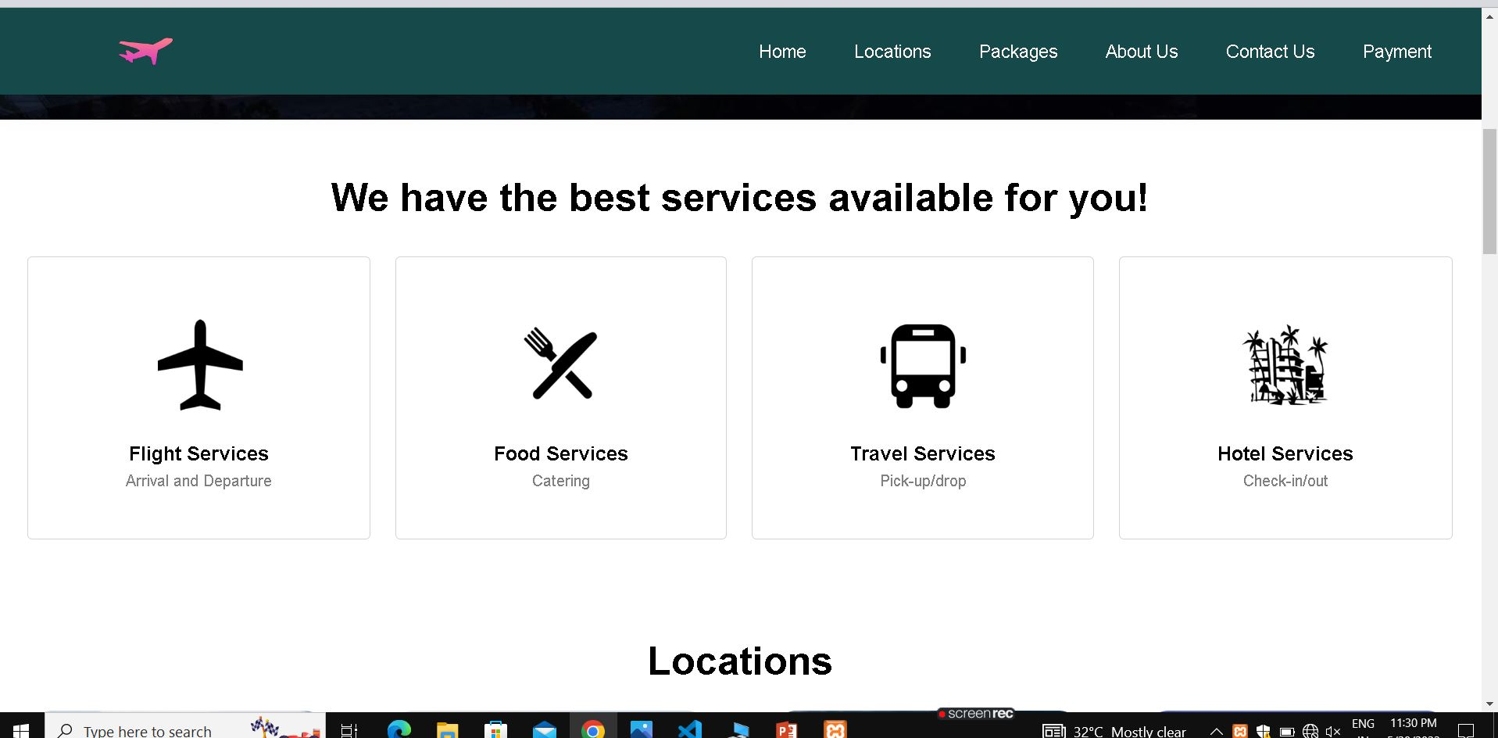

Slide 11
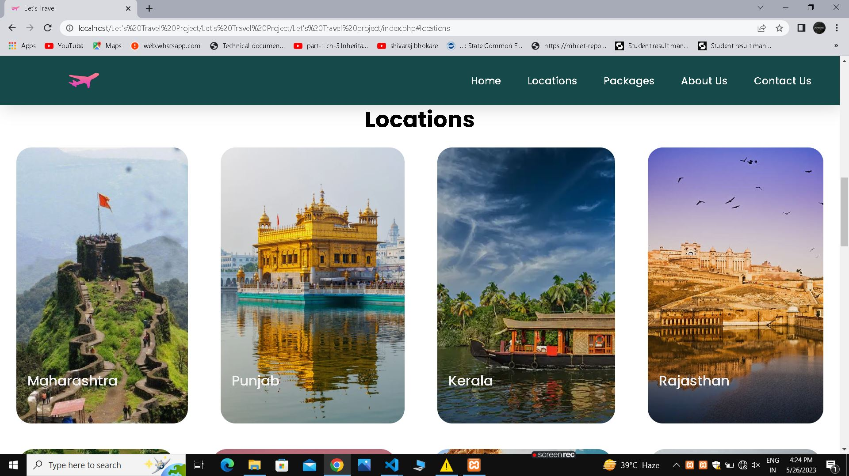

Slide 12
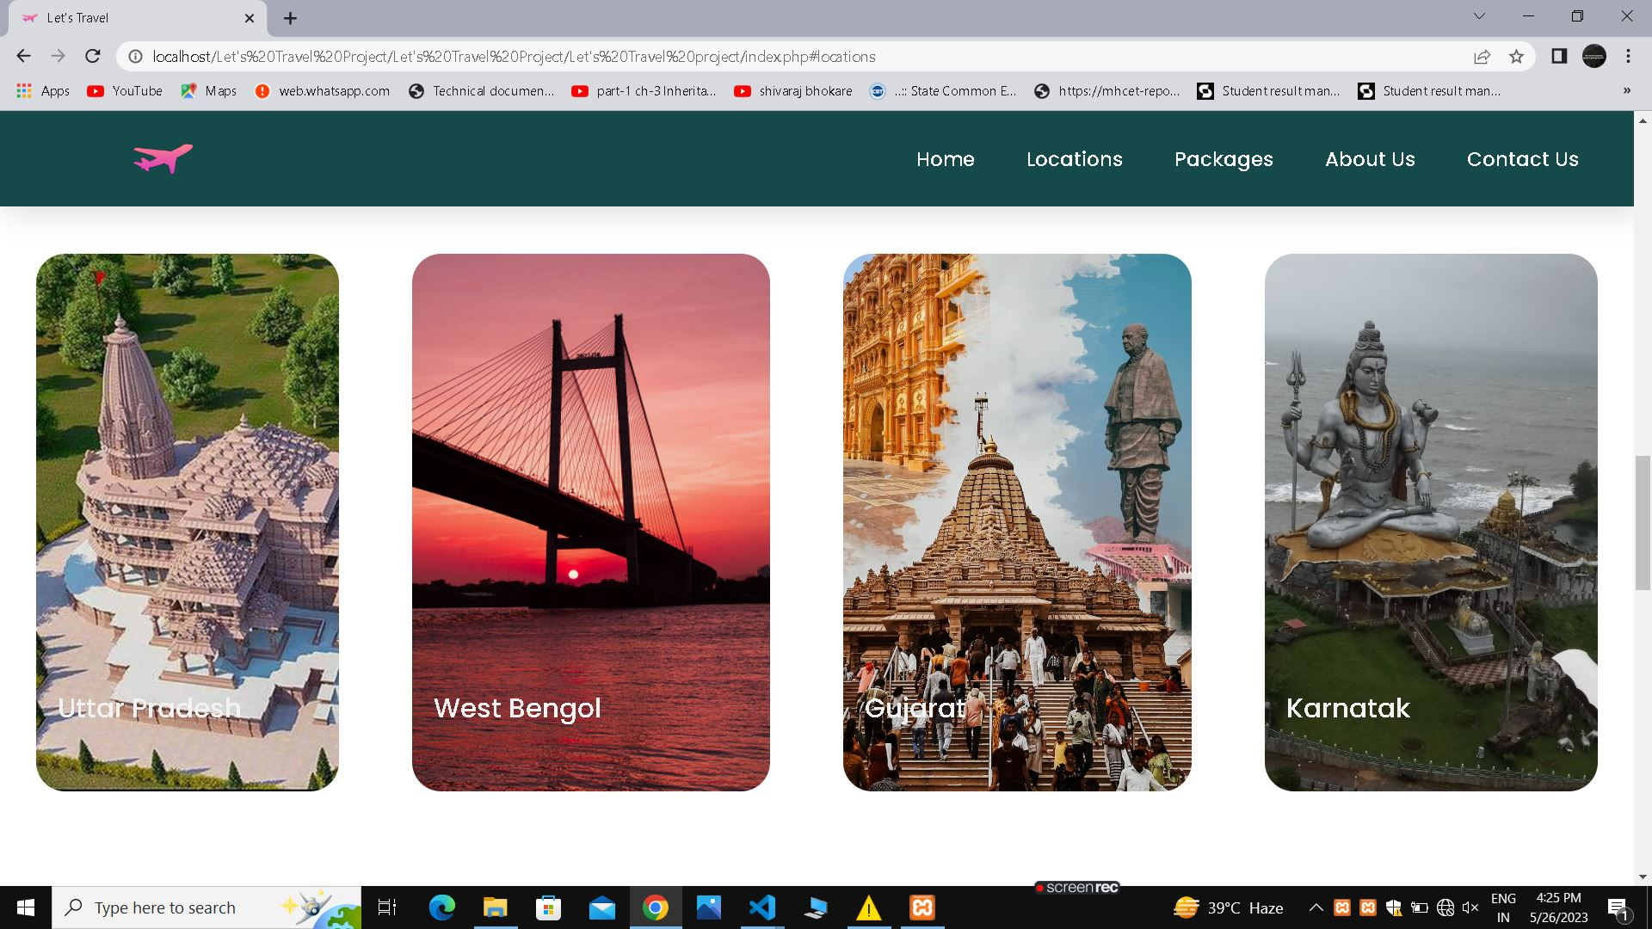

Slide 13
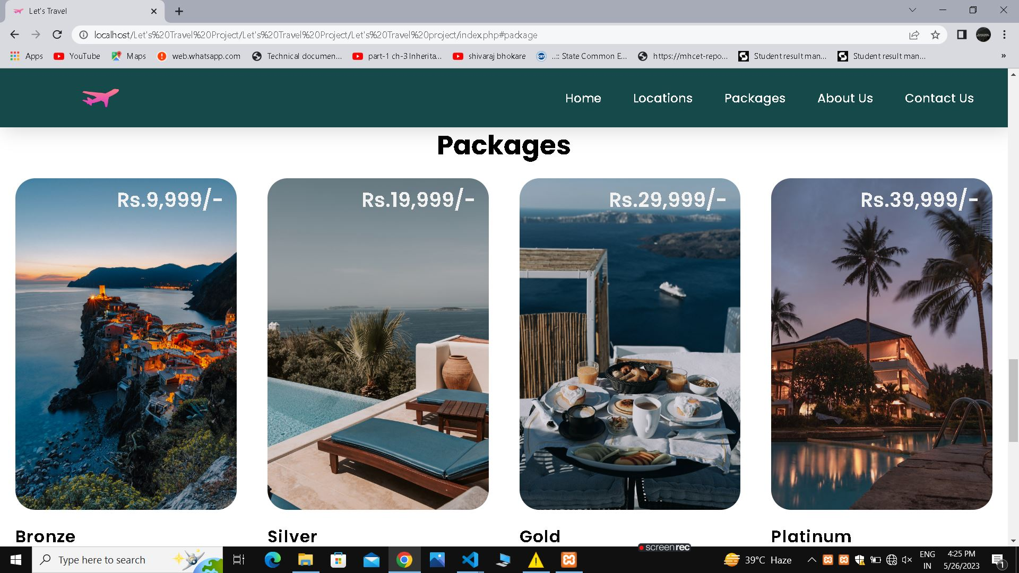

Slide 14
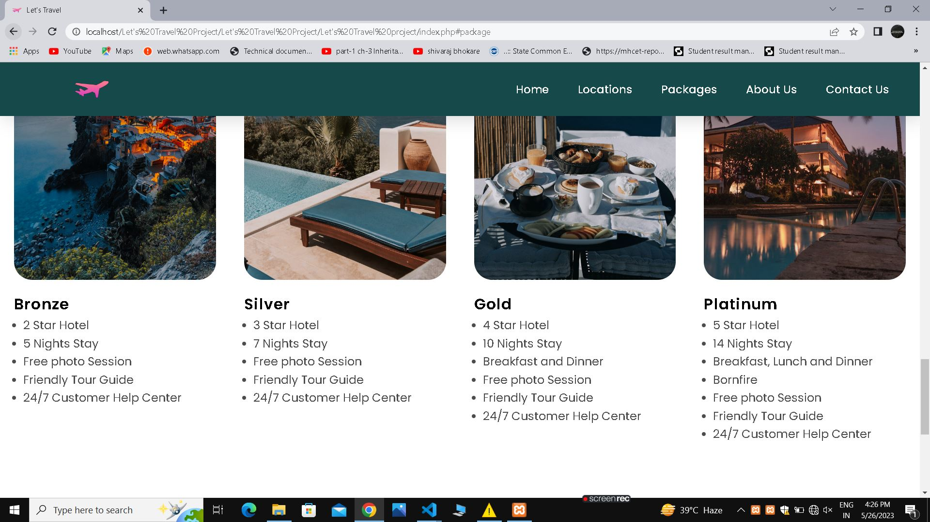

Slide 15
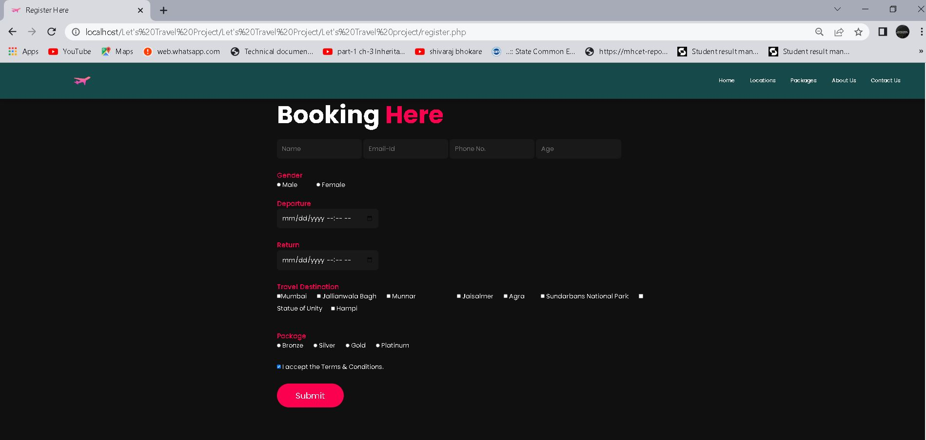

Slide 16
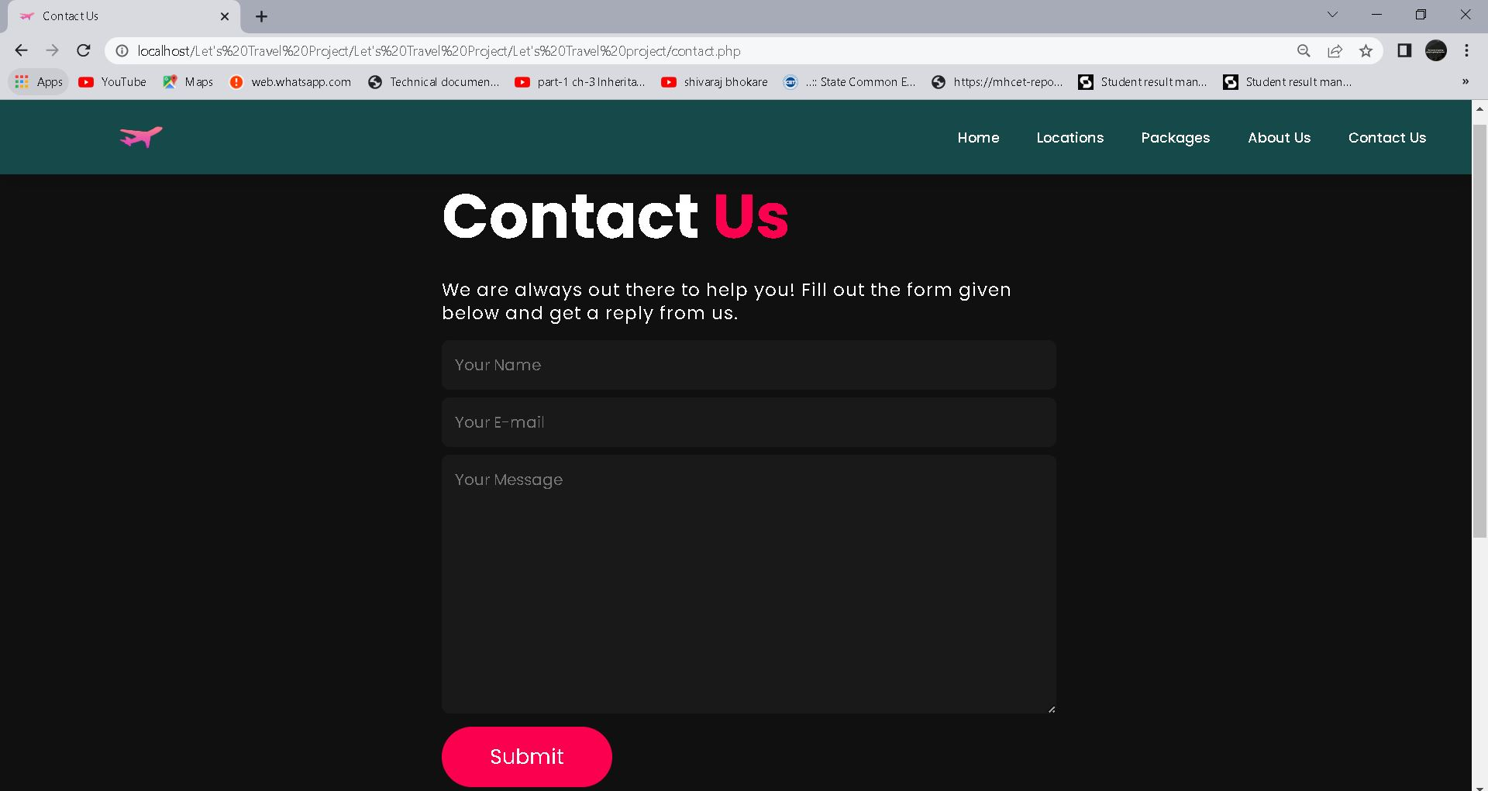

Slide 17
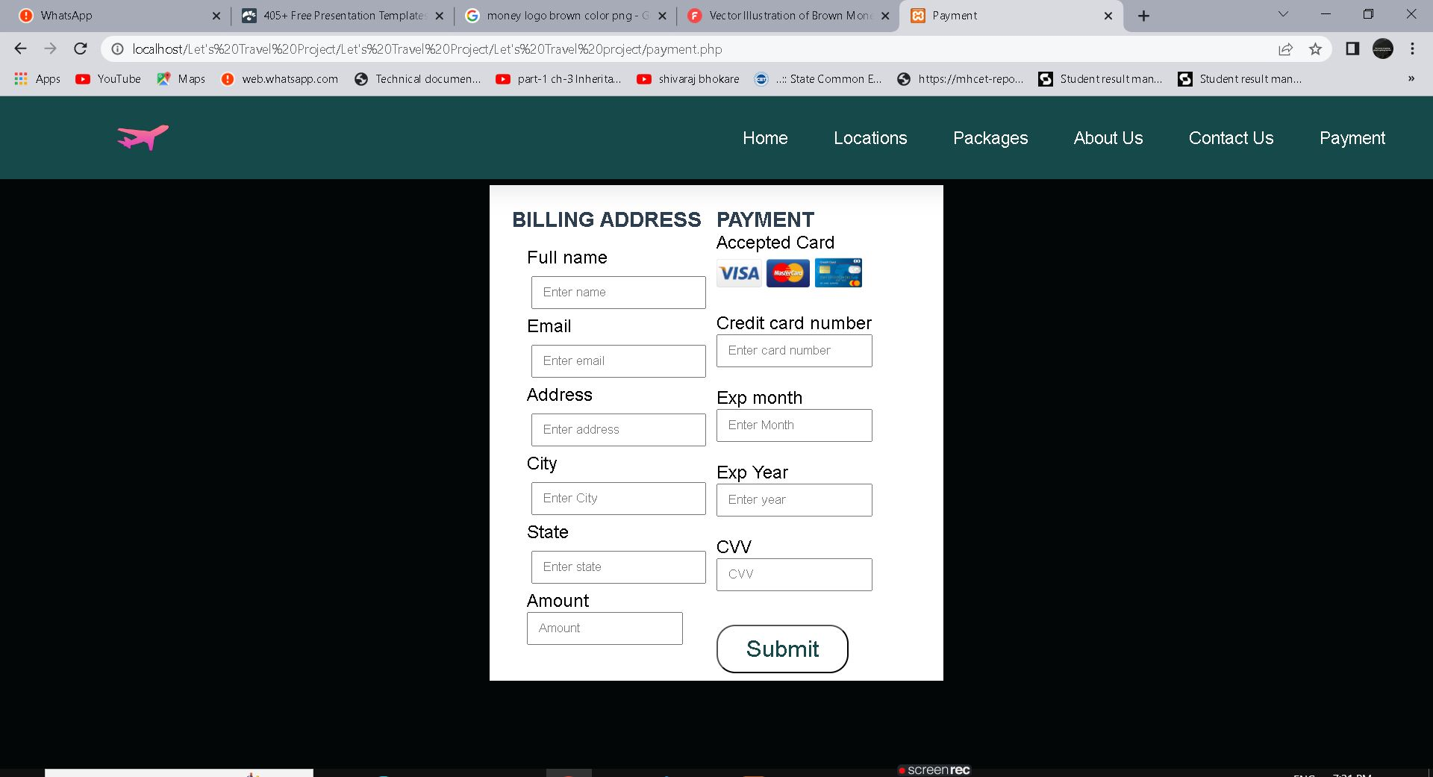

Slide 18
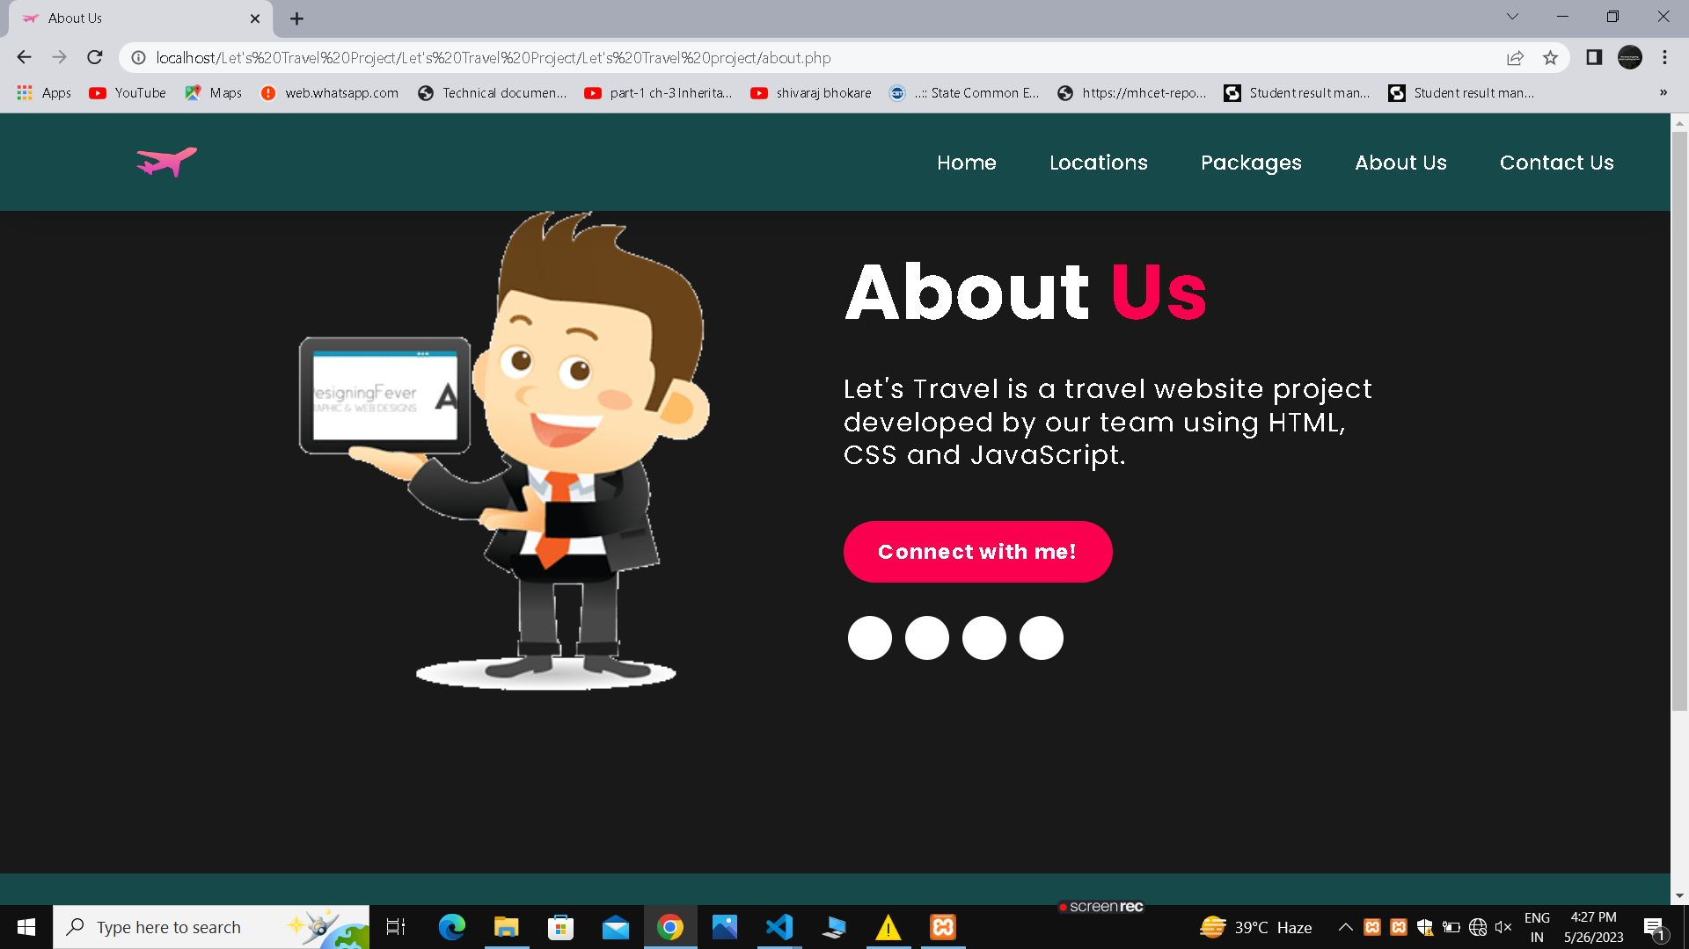

Slide 19
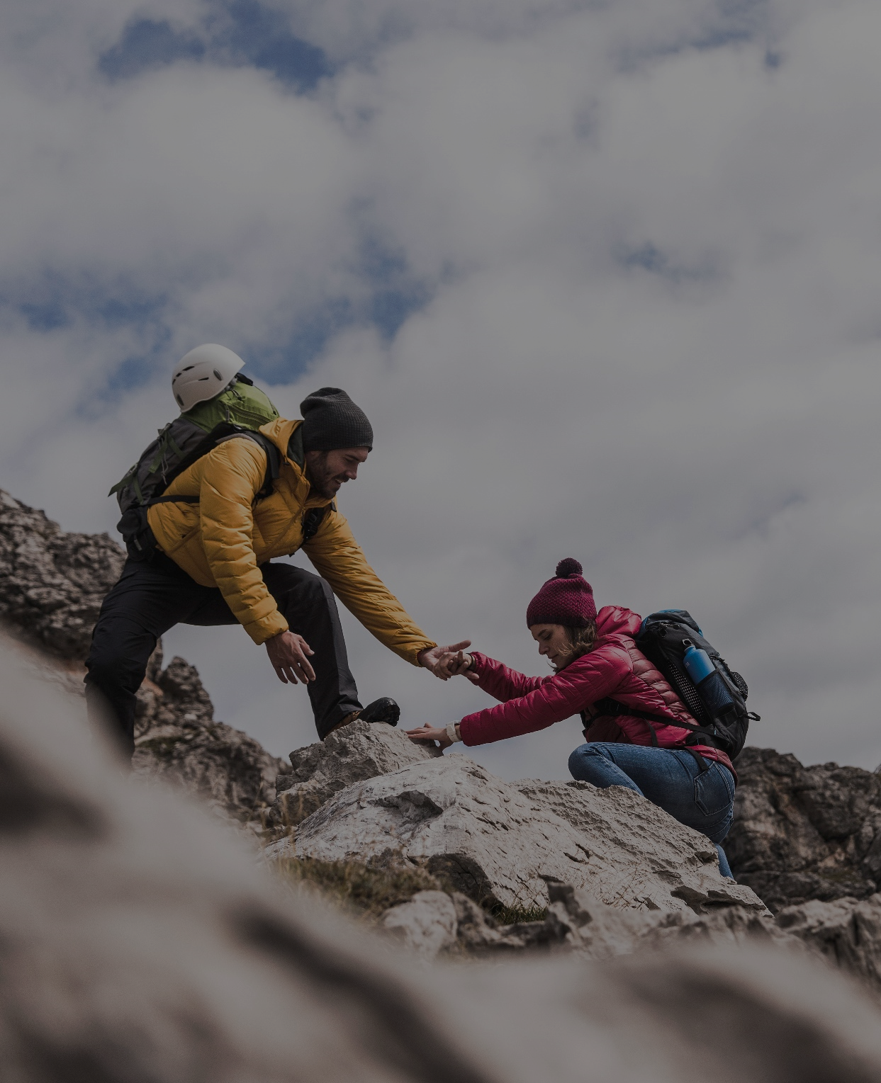
FUTURE SCOPE
We will include more functionality as per the user requirements.We want to improved our home page, as it is the main thing which attracts all user.
Not a single website is ever consider as complete forever firstly because there is always something new requirement also are growing day by day.

Slide 20
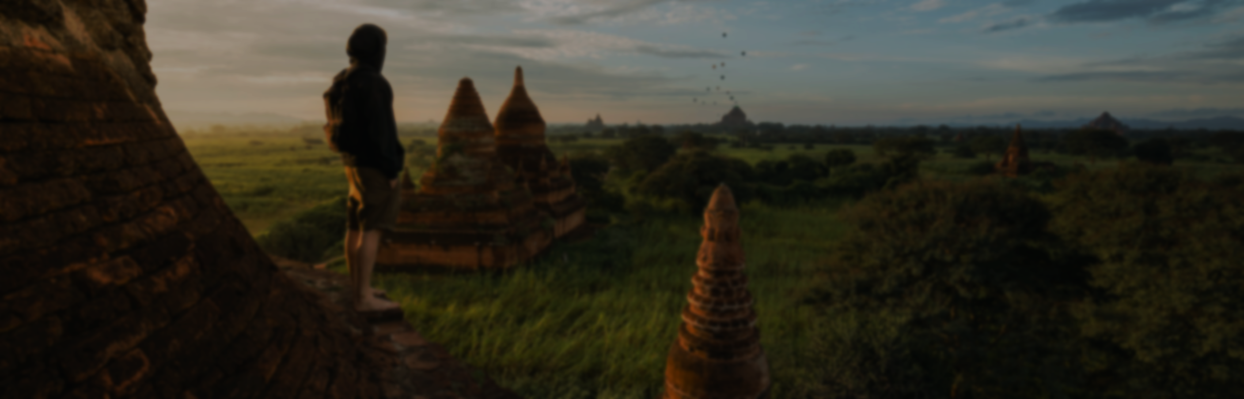
References
https://www.wikipedia.com
https://www.indiaToursOnline.com
https://www.realityToursandtravel.com
https://www.google.com

Slide 21

Thank you

